Slide 1
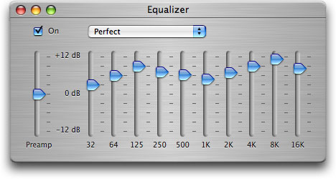
Filter design

Slide 2
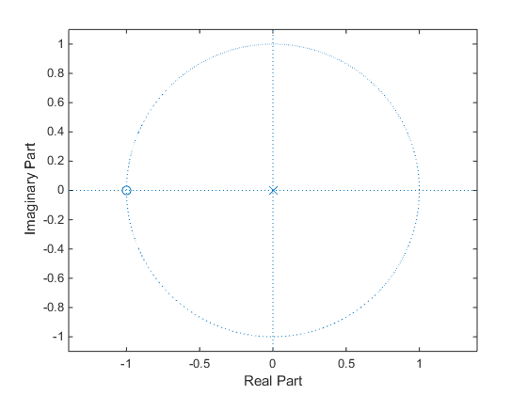
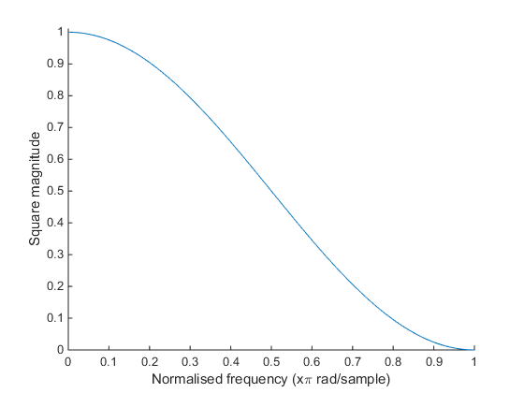
Pole zero plot and square magnitude response for simple prototype low pass filter

Slide 3
Transformations
Just by transforming this trivial filter, we can derive all the standard IIR filters
5 important transformations
Change gain at cut-off frequency
Shift the cut-off frequency
Low pass to low shelf
Invert the magnitude response
Low pass to band pass

Slide 4
Change gain at cut-off frequency.
|H|²
1
1/2
0
π/2
π
|H|²
1
G²
0
π/2
π

Slide 5
Shifting the centre frequency of a low pass filter.
|H|²
1
1/2
0
π/2
π
Normalized frequency ω
|H|²
1
1/2
0
ω_{c}
π
Normalized frequency ω

Slide 6
Shelving filter transformation.
|H|²
|H|²
G²
1
1
1/2
0
π/2
π
0
ω_{c}
π/2
π
Normalized frequency ω
Normalized frequency ω

Slide 7
Reversing the z domain to turn a lowpass into a high pass filter.
|H|²
0
π/2
π
|H|²
0
π/2
π

Slide 8
Transforming a low pass filter into a band pass filter.
|H|²
−π
−Β
0
B
π
B=ω_{u}-ω_{l}.
|H|²
0
ω_{l}
ω_{c}
ω_{u}
π

Slide 9
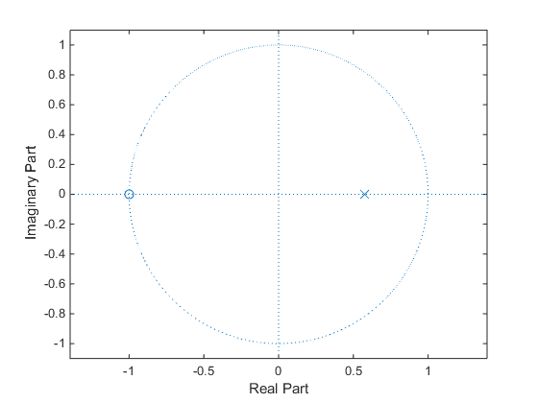
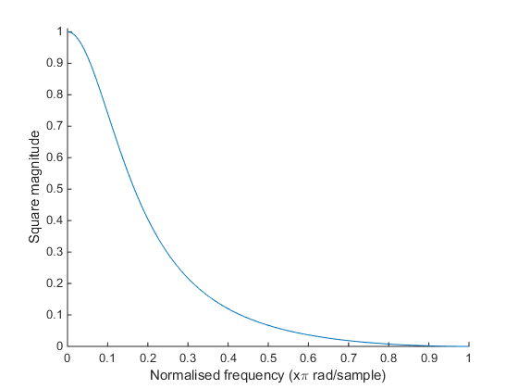
1st order low pass filter
Pole zero plot and square magnitude response
Prototype
Change gain at cut-off
→ Shift cut-off frequency

Slide 10
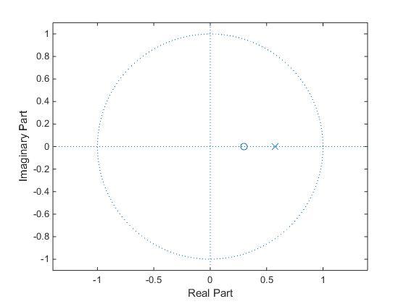
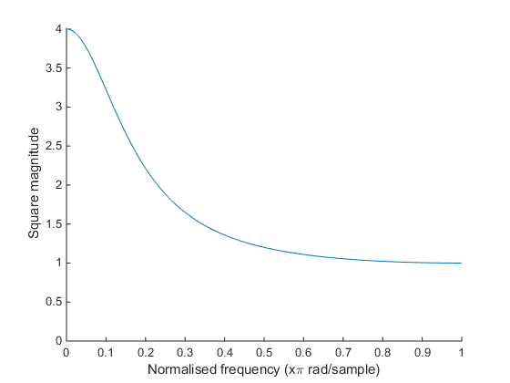
1st order low shelving filter
Prototype
Change gain at cut-off
Create shelf
Shift cut-off frequency

Slide 11
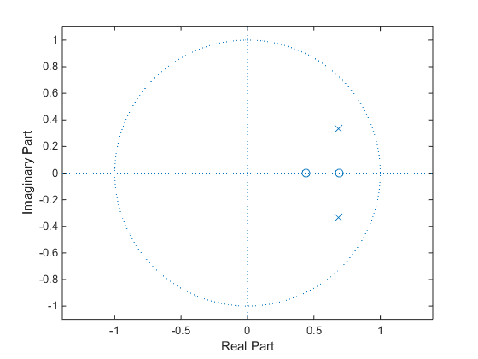
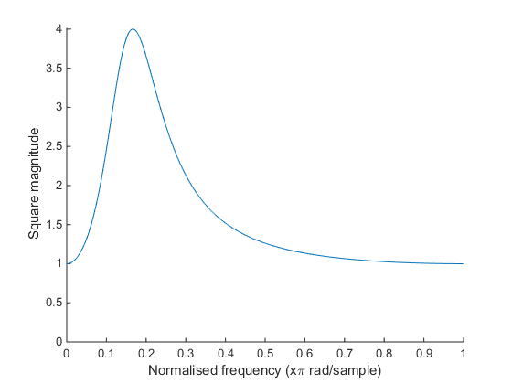
2nd order peaking/notch filter
Prototype
Change gain at cut-off
Create shelf
Shift cut-off frequency to B
Lowpass to bandpass

Slide 12
Transforms

Slide 13
Transfer functions

